Slide 1
Single-Vendor Open Source
Firms
Prof. Dr. Dirk Riehle
Friedrich-Alexander University Erlangen-Nürnberg
FOSS C06
Licensed under CC BY 4.0 International
Notes:
It is Friedrich-Alexander University Erlangen-Nürnberg – FAU, in short.
Corporate identity wants us to say “Friedrich-Alexander University”.

Slide 2
Open Source and Innovation
Legal innovation
Process innovation
Software tool innovation
Business model innovation

Slide 3
Evolution of Open Source Projects (Recap)
User consortia
2009
GenIVI Alliance
2005
Kuali Foundation
Single vendor (“commercial”) open source firms
1995
MySQL
2004
SugarCRM, Jaspersoft, Hyperic, ...
Developer foundations
2004 Eclipse Foundation
1999
Apache Software Foundation
2007
Linux Foundation
Distributor firms
1994
Red Hat
2004
Canonical
1992
Suse
2002
Univention
Service and support firms
2011
Hortonworks
1989
Cygnus Solutions
2005
Automattic
2009
MariaDB
Community projects
1987
GCC
1993
Debian
1984
GNU Emacs
1991
Linux kernel
1996
PostgreSQL
2004
CentOS
year
Not a complete history: Events have been chosen for illustration purposes

Slide 4
Open Source “Business Models” (Recap)
Non-profit open source
  Community projects without foundation
  Open source developer foundations
  Open source user foundations
For-profit open source
  Service and support firms
  Open source distributor firms
  Single-vendor open source firms

Slide 5
Single-Vendor Open Source Project
A single-vendor open source project
  Is an open source project that is tightly controlled by one vendor
Legally, the project may be open source
  Practically, it is not: Rather it is a proprietary project
    There is much more to an open source project than a license
  Proprietary = One proprietor (owner)
Single-vendor open source is the new proprietary source

Slide 6
Single-Vendor Open Source Firms
A single-vendor open source firm
  Is the software vendor behind a single-vendor open source project
  Owns and provides the project as its main product

Slide 7












Examples of Single-Vendor Open Source Projects / Firms

Slide 8
“Gartner Predicts” (2010)
“By 2012, at least 50% of direct commercial revenue attributed to open-source products or services will come from projects under a single vendor’s patronage.” [D10]

Slide 9
Community vs. Commercial Edition
Community edition
  Core product provided under an open source license
Commercial edition (a.k.a. professional or enterprise edition)
  Whatever customers are willing to pay for, i.e.
    Basic product, bundle of usage rights to
      Core software under a commercial license, additional software
      Guarantees and certifications
      Support services
    Whole product, i.e. basic product +
      Proprietary extensions
      Training and consulting
      Operations
Sometimes called the “open core” business model [L09]

Slide 10
Jaspersoft Commercial Offering (2010) [WR13]
Web Store
Direct Sales
DOC
Documentation
INC
Incident-based support
Open Source
Community
DOC
INC
UTIL
UTIL
Utilities
LIC
Commercial license
Enterprise
Customers
LIC
UPD
UTIL
DOC
TRN
24x7
UPD
Update service
TRN
Training
ISV/OEM
LIC
UTIL
...
DOC
TRN
24x7
24x7
24x7 hot-line

Slide 11
Why Pay for Open Source Products?
“Some people spend time to save money, some spend money to save time.” [M10a]

Slide 12
Original Single-Vendor Open Source
Entrepreneur
  Identifies market opportunity
  Founds company
  Acquires funding
Company
  Develops software from scratch
  Goes to market by releasing software as open source
  Maintains rights to intellectual property

Slide 13
More Recent Single-Vendor Open Source
Entrepreneur
  Identifies market opportunity around existing project
  Founds company
  Acquires funding
Company
  Develops software by building on community project
    Where “building on” means
      Hires as many original developers as is possible
      Develops product based on community project
  Goes to market by releasing extensions as open source
  Maintains proprietary rights to extensions

Slide 14
Time-line of Single-Vendor Open Source
Mid-1990 to early 2000
  Early adopters, trailblazers
    Sleepycat, MySQL, The Qt Company
Mid-2000 to early 2010
  Strategic adopters addressing markets ripe for disruption
    SugarCRM, Jaspersoft, Mulesoft
Since late 2000
  Second-generation, around communities
    Hadoop: Cloudera, MapR, Hortonworks

Slide 15





NoSQL Databases and Firms

Slide 16
Benefits of Open Source Approach
Significant benefits for
  Marketing and sales
    Market faster, sell more effectively
  Business development
    Identify partner opportunities better
  Product management
    Build a superior product faster
  Software development
    Build a product at lower cost

Slide 17
Benefits to Marketing and Sales
Marketing
  Community word-of-mouth evangelizes product
  Community creates wider outreach than possible without
Sales
  Existing in-house use of product creates credibility
  Sales is frequently aided by in-house champion

Slide 18
Open Source Sales Funnel
Download
Install
Use
Lead
Prospect
Sale
Customer

Slide 19
Open Source Sales Process
Market product
Engage in
comp. sales
Win sale!
Provide open source
Track users
Generate leads
from behavior
Connect users
of organization
Identify champion
Make sales call

Slide 20
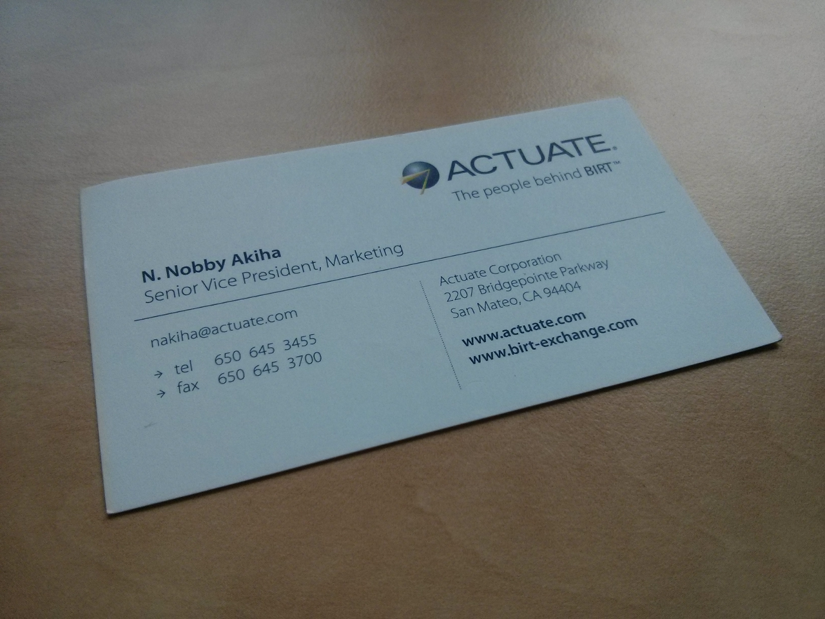

Slide 21



Using Foundations as a Marketing Channel

Slide 22
Benefits to Business Development
User innovation helps identify strategic partners
Smart single-vendor firms set-up their own forge

Slide 23
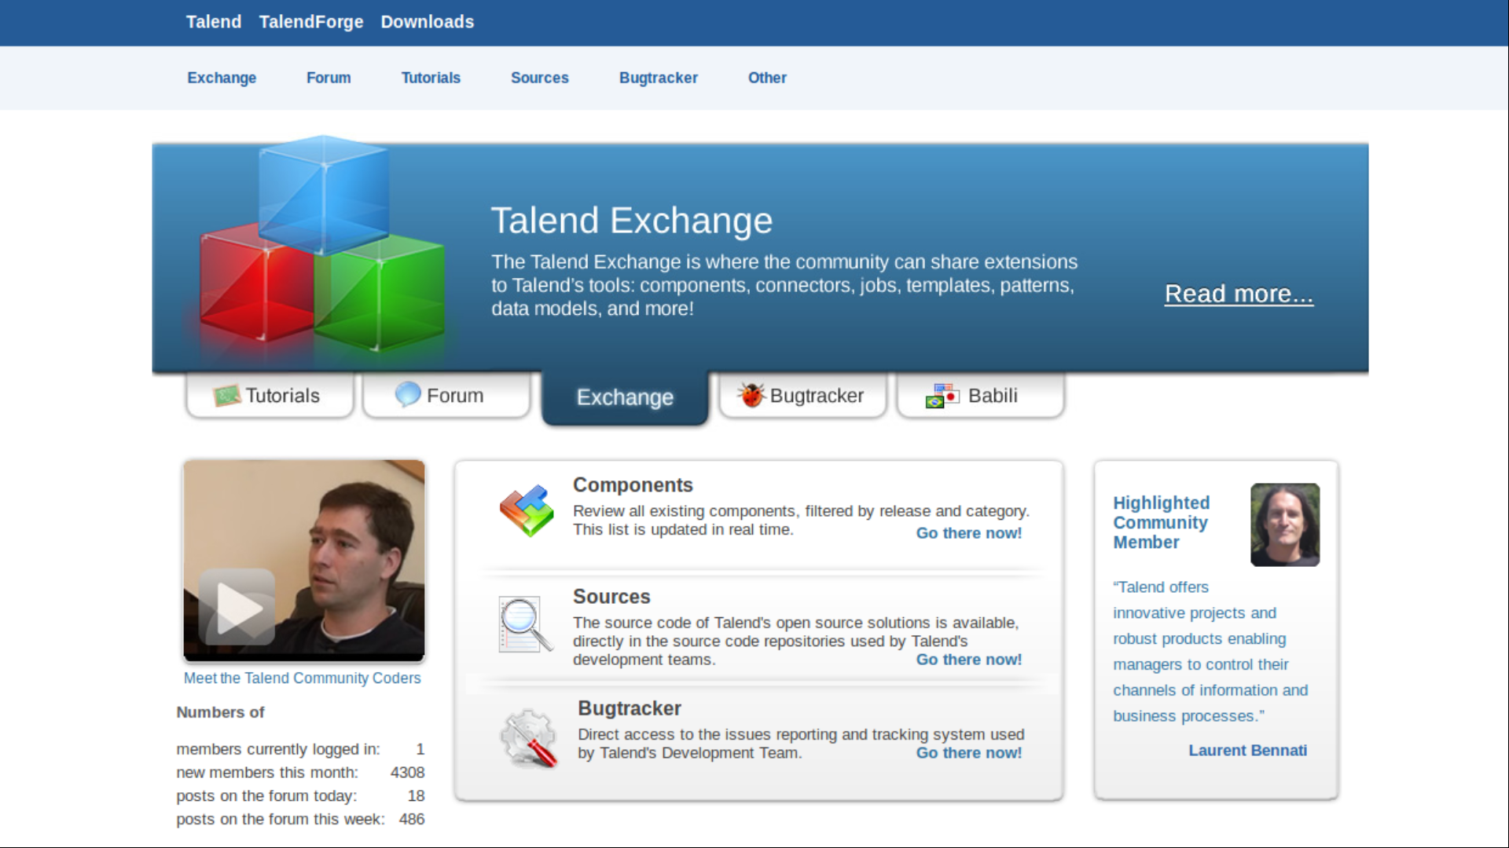

Slide 24
Benefits to Product Management
A well-working community
  Provides fast and direct feedback
  Provides alternative solutions, ideas
  Explores extensions, niche markets for free
  Signals new needs, strategic alliances

Slide 25
Challenge to Product Management
Community Version
  Home user
    Will never pay money
    But pays with time, feedback
  Line-of-business user
    Likes $0 line-items
    Somewhat ignorant of risks
Commercial Product
  Enterprise customer
    Is willing to pay
    Requires enterprise features
  Internal IT department
    Has appropriate budget
    Wants professional support

Slide 26
Benefits to Software Development
A well-working community
  Finds bugs fast, sometimes provides fix, ultimately lowers costs
  Helps explore design decisions, develops prototypes to learn from
  Serves as a recruiting source
“Source code [is just] 10% of the effort.” [L07]

Slide 27
Costs of Open Source Approach
Additional costs in
  Software development
  Intellectual property management
  Community management
Benefits outweigh the costs

Slide 28
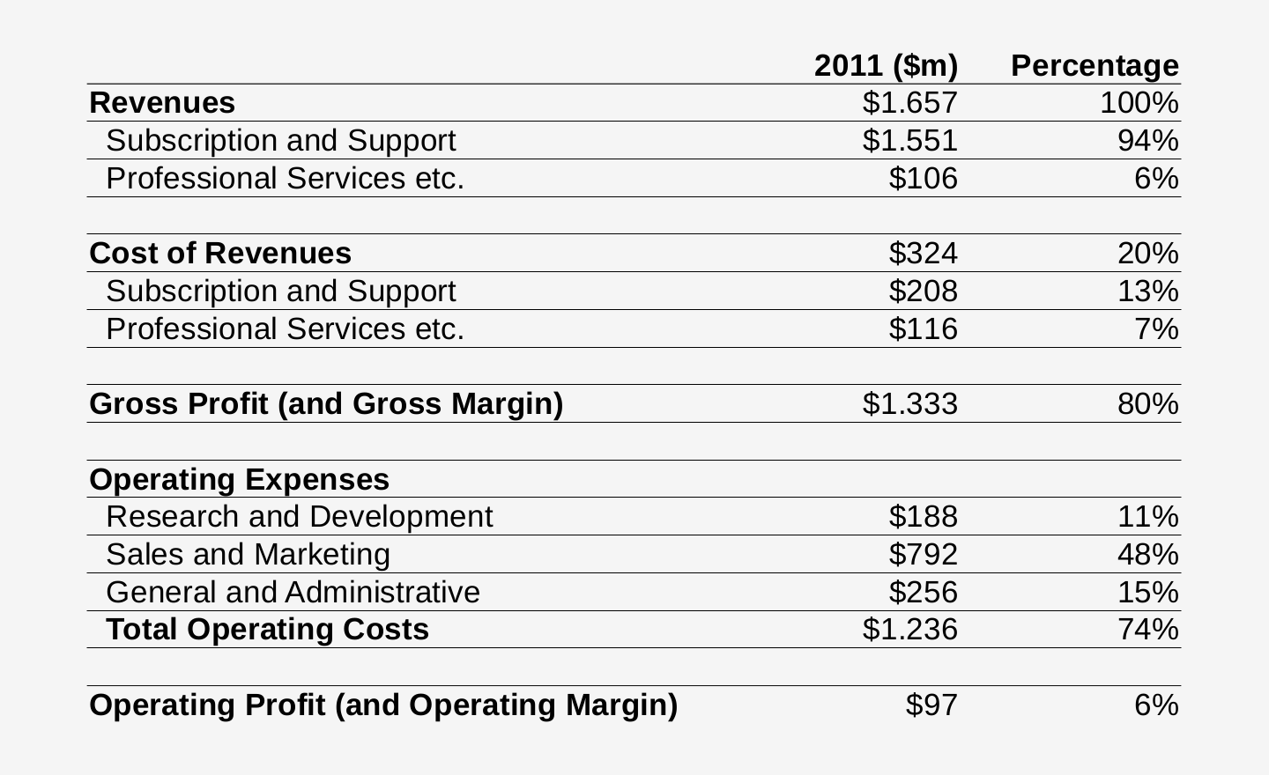
Operating Expenses of a Software Vendor [C12]

Slide 29
Approach Requires New Capabilities
Single-Vendor Open Source
$
IP
Open Source Community

Slide 30
Intellectual Property Management
Intellectual property rights imperative [R09]
  “Always act in such a way that you, and only you, possess the right to provide the open source project under a license of your choice.”
Use reciprocal license to keep competition away
  Almost all single-vendor-owned commercial open source is provided under a reciprocal license, typically the AGPL v3
Use contributor agreement to maintain ownership
  Almost all single-vendor open source firms require copyright transfer for any contributions to maintain full IP ownership

Slide 31
Application vs. Component Single-Vendor Open Source
Application vendors usually dual-license
  AGPLv3-only to drive adoption by enterprise users
  Commercial license for paying customers
Component vendors currently multi-license
  Permissively licensed open source to drive adoption by application developers
    AGPLv3-only for software core to keep competition away
    Permissive open source license for component adapters / connectors / client libraries to drive adoption
  Commercial license for paying customers
How to handle competition from cloud computing providers?

Slide 32
Solving the Component Vendor Conundrum with Triple Licensing
Dual-licensing (old)
Triple-licensing (new)
MIT
commercial license
AGPLv3
commercial license
SSPL / BSL / etc.
(almost open-source license)
AGPLv3
MIT
1
2
1
2
3

Slide 33
Control Mechanisms [R11a] [A10b]
Copyright
Trademarks
Domains

Slide 34
Steering Mechanisms
Social leadership
Development process
Strategic positioning

Slide 35
Community Management
Community management
  Is a business function tasked with
    Creating, growing, and maintaining
    A self-sustaining open source community
    Around the vendor’s products
Community manager
  Is a role (but often now a full-time position)
    Tasked with community management

Slide 36
Community Proportions
Passive
Consumers
100-
10000x
Active
Users
10-
500x
Firm
Employees
1

Slide 37
Revenue Proportions
Non-paying
Users
0%
Webstore
Sales
0-1%
Enterprise
Sales
99-
100%

Slide 38
Business Model of Single-Vendor Firms
Key
Activities
Customer Relationships
Key Partners
Customer Segments
Value
Proposition
Key Re-sources
Channels
Cost Structure
Revenue Streams

Slide 39
Responsibilities and Challenges
Create community
  Pull members on board
  Make members return, stay
Grow community
  Lead community to help each other
  Enable self-sustaining growth
Manage community
  Maintain community peace
  Facilitate community benefits

Slide 40
Life-cycle of Single-Vendor Firms
Early years
  Full fair open source play
Growth years
  Full fair open source play
Maturity
  Increased closing of product

Slide 41




Commercial Forks

Slide 42
Review / Summary of Session
Single-vendor firms
  Definition and history
  Benefits and challenges
  Life-cycle of firms and products

Slide 43
Thank you! Questions?
dirk.riehle@fau.de – http://osr.cs.fau.de
dirk@riehle.org – http://dirkriehle.com – @dirkriehle
DR

Slide 44
Credits and License
Original version
  © 2012-2019 Dirk Riehle, some rights reserved
  Licensed under Creative Commons Attribution 4.0 International License
Contributions
  ...

